Slide 1
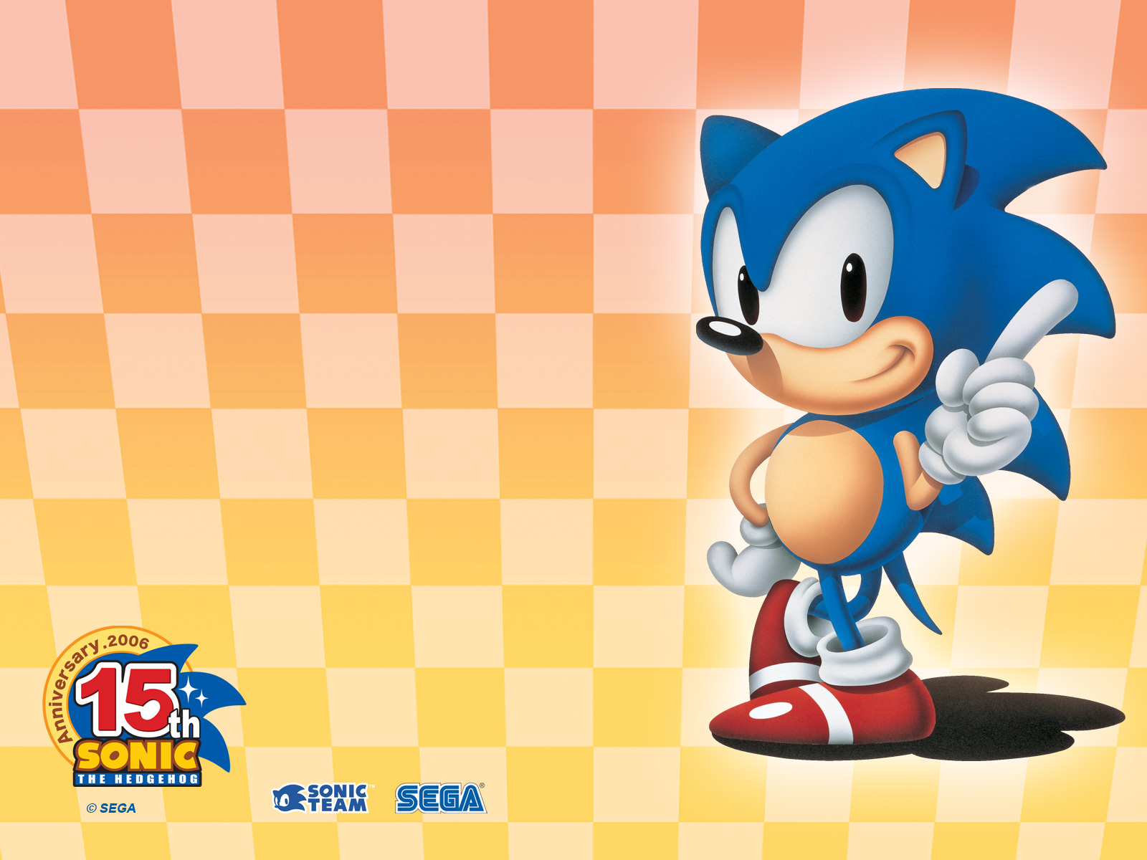
The MorphoxX Project
Jean-Baptiste Fiot
March 2009

Slide 2
Goal and motivations
Goal: tool to deform quickly 3D model
  Cage-based methods
    3 coordinate systems studied in this project
Let's do a quick demo!
Applications:
  Animated movies
  Video games

Slide 3
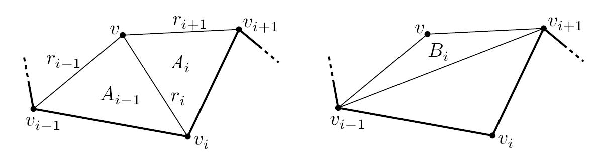
Mean Value Coordinates
Generalized barycentric coordinates.
Coordinates are normalized in the end

Slide 4
Mean Value Coordinates

Slide 5
Mean Value Coordinates
Progressive deformations:

Slide 6
Mean Value Coordinates
Using nearest pixel instead of interpolation:

Slide 7
Mean Value Coordinates

Slide 8
Harmonic Coordinates
Defined on the interior of the cage
Creation of a mask
Initialization on the boundaries
Propagation in the interior via 4c-averaging

Slide 9
Harmonic Coordinates

Slide 10
Harmonic Coordinates
Progressive deformations:

Slide 11
Harmonic Coordinates
Require enough iterations
  Examples with 100, 500, 2000, 5000, and 20000 iterations:

Slide 12
Harmonic Coordinates
Sonic 300*450, 29 vertices, 25000 iterations
  Born after 21 hours of computation on a Dell XPS Gen 2 with proc Intel Pentium M 2.13 GHz...
  but he is cute, isn't he?

Slide 13
Green Coordinates
Added terms based on face elements to have coordinates respecting the cage's faces' orientations
TRICK: Normalisation of the vertex-based terms (to be origin invariant: previous formulation: affine space ↔ vectorial space)

Slide 14
Green Coordinates

Slide 15
Green Coordinates
Progressive deformations:

Slide 16
Green Coordinates
Note the flexibility to allow the model to step out of the cage (continuity outside not implemented)

Slide 17
Comparison
Original – MVC – HC – GC:

Slide 18
Comparison
Initial – MVC – HC – GC:

Slide 19
Conclusion
 | MVC | HC | GC
Computing time
Simplicity
Flexibility | No | No | Yes
Defined everywhere | Yes | No | Yes
Partial deformations |  | No
Source code available at http://code.google.com/p/morphoxx

